Slide 1

Hidden IoT-Based Safety Device for Kidnapping Prevention
Real-time emergency alert system for vulnerable populations

Slide 2

The Safety Crisis We Face
Rising Threats
The Critical Gap
Kidnapping incidents targeting women and children increasing alarmingly
Need for discreet, autonomous, intelligent protection
Silent emergency alerts without user interaction
Victims unable to access phones or panic buttons during abduction
Real-time location sharing to police and guardians
Existing solutions visible, detectable, require manual activation

Slide 3





Project Objectives & Innovation
Primary Goal
Core Capability
Concealed IoT emergency alert system for kidnapping scenarios
Real-time location tracking and multi-stakeholder notification
Design Focus
Integration into personal belongings—bags, accessories—undetected operation
Social Impact: Prioritising protection for marginalised and high-risk groups

Slide 4




System Architecture Overview
Sensing Layer
Communication Layer
Response Layer
Microcontroller, GPS, GSM, activation sensors
GSM module sends SMS/call alerts to contacts
Guardians and authorities receive location-based alerts

Slide 5
How the Device Works
Idle Monitoring Mode
1
Continuous sensor monitoring, low power consumption
2
Trigger Detection
Button press, voice command, or abnormal movement detected
Module Activation
3
GPS fetches location coordinates, GSM prepares alert
4
Alert Transmission
Emergency SMS/call sent to police and guardians with real-time location
Continuous Tracking
5
Optional live tracking via app or dashboard

Slide 6
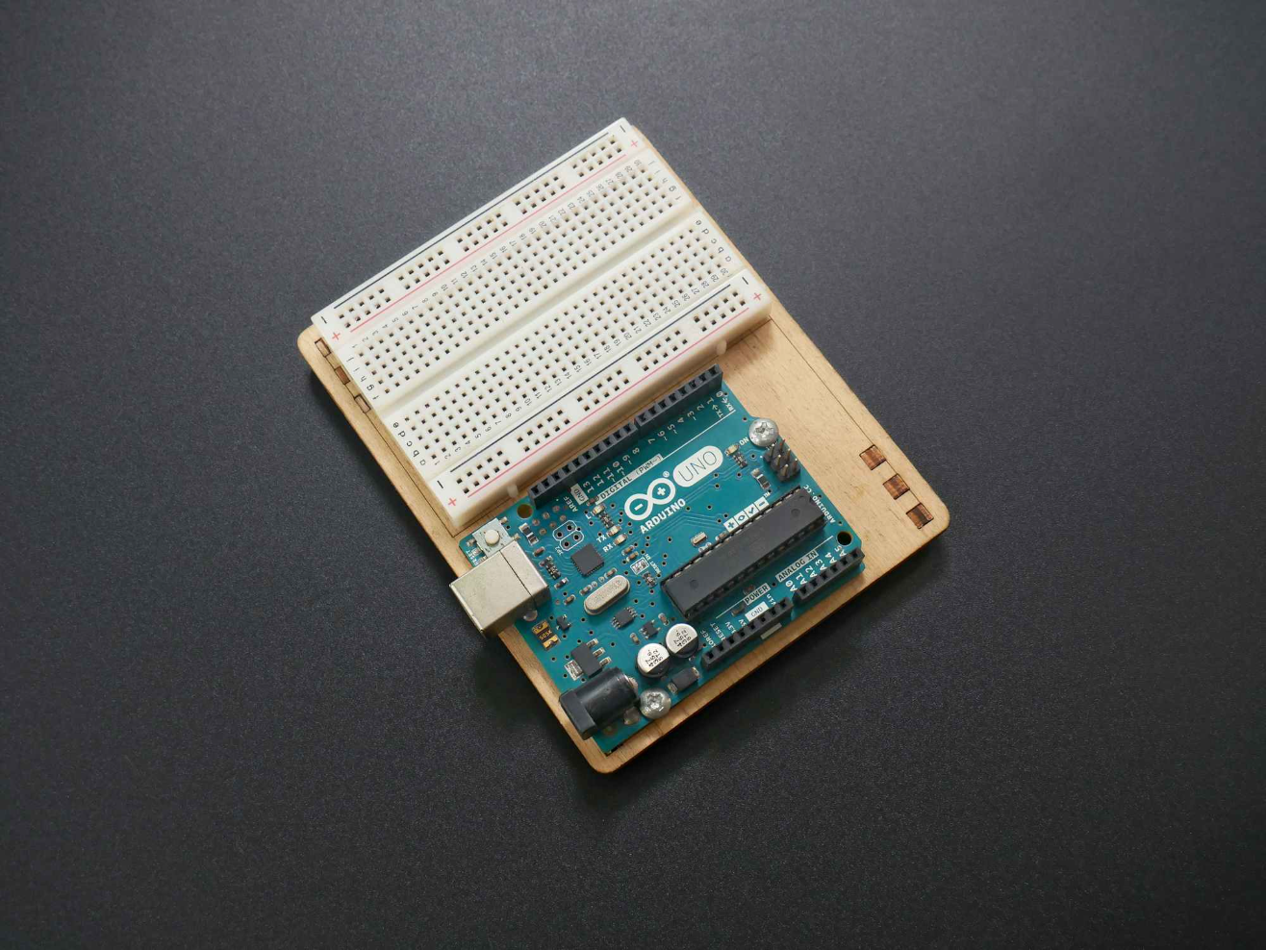
Hardware Implementation
Core Components
ESP32/Arduino Nano
Neo-6M GPS Module
Low power microcontroller with sufficient I/O
Real-time location tracking with high accuracy
SIM800L GSM Module
Activation Sensors
SMS and call-based alert transmission
Push button, voice recognition, motion detection
Li-ion Battery
Rechargeable power with voltage regulation

Slide 7

Results & Performance
<3s
95%
24h
Alert Response Time
Location Accuracy
Battery Life
Continuous monitoring on single charge
From trigger to message transmission
GPS coordinates precision in field testing
Key Achievements
Autonomous trigger detection and alert transmission validated
Compact design successfully concealed in personal items
Reliable GSM communication in urban and semi-urban areas
Low-cost, scalable solution for vulnerable communities

Slide 8
Challenges & Limitations
Technical Hurdles
Design Constraints
GSM Network Dependency: Poor signal coverage affects reliability
Size Limitations: Compact form factor limits component selection
Sensor Calibration: Balancing sensitivity to avoid false triggers
No User Interface: Limited advanced tracking features
Environmental Testing: Durability under various conditions needed
Battery Constraints: Continuous monitoring drains power quickly
Cost Optimisation: Balancing functionality with affordability
Integration Complexity: GSM and GPS module synchronisation delays

Slide 9





Future Enhancements
Mobile App Integration
Live tracking dashboard, remote configuration, alert history access
Biometric Activation
Fingerprint or voice authentication to prevent false triggers
Multimedia Evidence
Audio recording and camera modules for incident documentation
Alternative Connectivity
LoRaWAN, NB-IoT for extended range and low power consumption
Enhanced Power Management
Solar charging, energy-efficient sleep modes, smart algorithms
"By combining technology with social impact, we can transition from prototype to scalable solution—contributing meaningfully to public safety for vulnerable communities."

